Slide 1
On MIMO Relay Network with Finite-Rate Feedback and Imperfect Channel Estimation
Byung K. Yi, Shu Wang and Soonyil Kwon
LG Electronics Mobile Research USA

Slide 2
Outline
Problem description
The role of feedback and its imperfection.
Hamming approximation for codebook vector quantization errors
Cramer-Rao bound for channel estimation errors
Sphere packing bound for the reliability of AWGN channel with noisy feedback.
Some asymptotic results and discussions

Slide 3
Introduction
MIMO brings an additional dimension as well as new challenges into next generation wireless system design. Relay network with MIMO is believed to be the next frontier for relieving network from capacity and coverage limits.
Many existing discussions of MIMO precoding mismatch with finite-rate feedback are based on the assumptions such as: [Mukkavilli et al., 03; Xia and Giannakis, 04; Roh and Rao 04 ]
  The forward-link channel estimation or reverse-link feedback channel is perfect;
  Beamforming distortion is mostly decided by channel quantization error.
In the current system development, a more accurate closed-loop MIMO beamforming model is desired to include
  Forward-link channel parameter estimation errors,
  Reverse-link channel feedback errors, and
  Vector quantization errors
In this discussion, we want to understand how imperfect channel estimation/quantization and channel feedback affect MIMO beamforming, such as
  some performance bounds: channel estimation/quantization, etc.
  some scalability results in terms of codebook size, pilot size, Tx power, etc.
  some asymptotic conclusions we can learn for upper layer design.

Slide 4
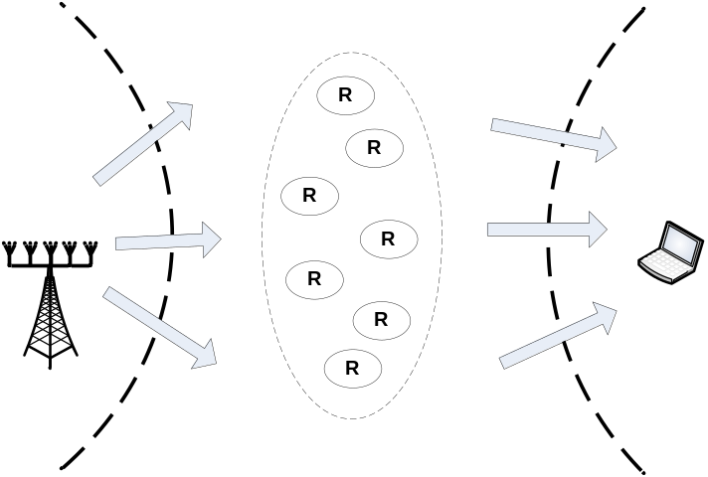
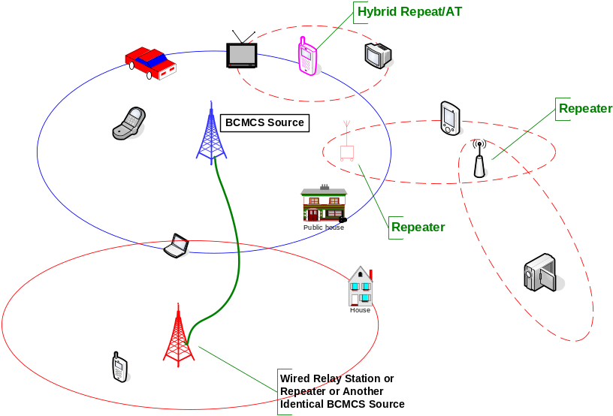
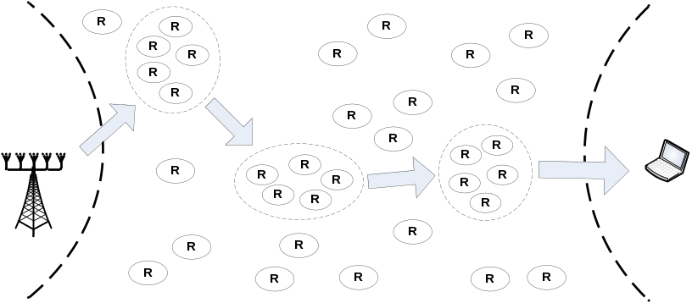
MIMO Relay Communication Scenario

Slide 5
MIMO Channel Capacity
Noncoherent MIMO:
  Channel H is unknown to Tx/Rx.
  C = K ( 1 - K / T )log(SNR) + O(1), where K = min{ M, N, T/2 }. [ Zhang and Tse, 2000 ]
Coherent MIMO:
  H is known to Rx only: C = min(M, N) log(SNR) + O(1).
  H is known to Tx/Rx: C = min(M, N) log(SNR) + O(1). [Blankenburg and Wyner, 1970’s; Foschini and Telatar 1995]
In higher SNR region, that transmitter knows the channel may not help much in terms of achievable channel capacity.
However, CQI at Tx can help simplify receiver design.
  Perfect CQI feedback is too expensive. It is not reasonable to feedback M*N complex values
  Finite-rate feedback with channel quantization is the more practical approach.

Slide 6
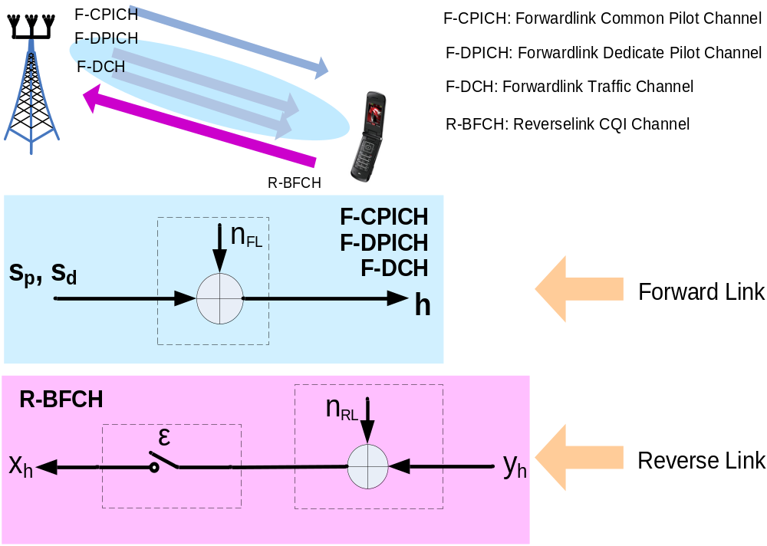
MIMO BF Model with Feedback

Slide 7
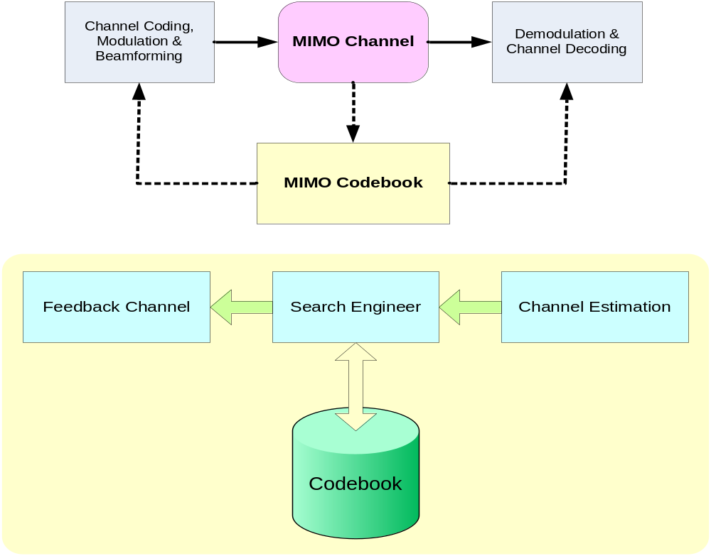
MIMO BF with Limited-Rate Feedback

Slide 8
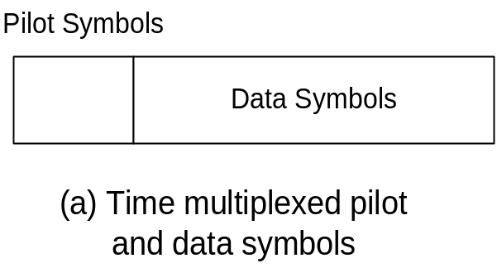
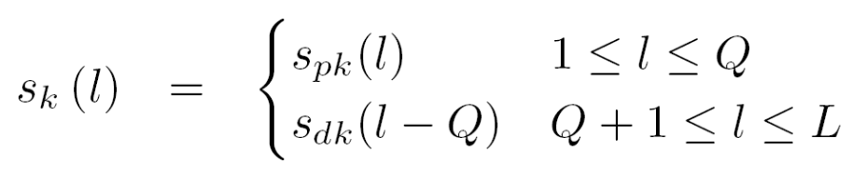
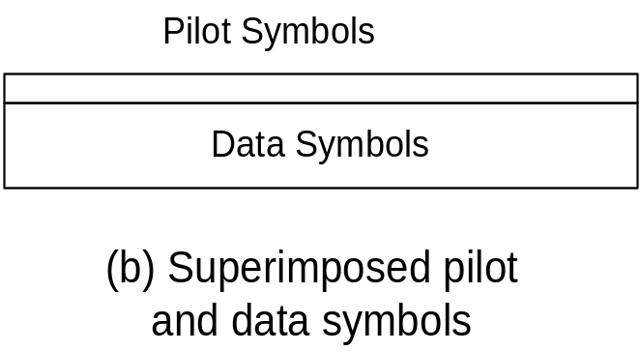
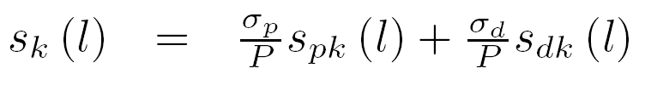
Forwardlink Pilot/Data Channel Design

Slide 9
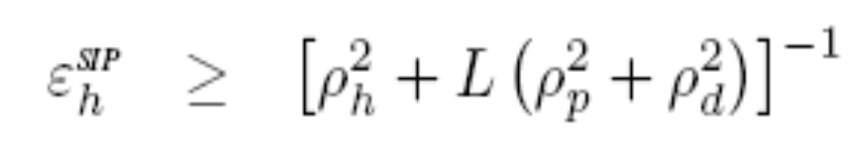

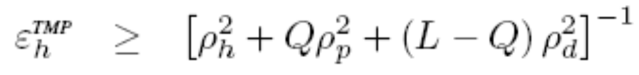
Cramer-Rao Bound on Channel Estimation

Slide 10
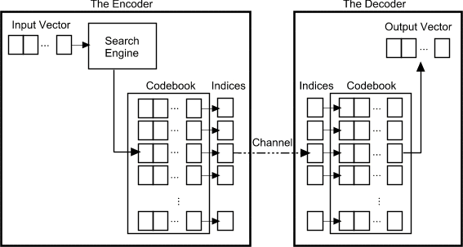
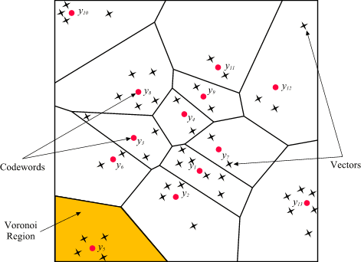
Vector Quantization and Codebook
Generally, the quantizer maps the input vector to the index of a codeword in the codebook. The decode will do the reverse.
  Speech coding. VQ in EVRC, 4GV, AMR, etc.
  Video/Audio Compression. E.g., TwinVQ in MPEG-4
  MIMO CQI Generation. HS-DPCCH in HSDPA Rel. 6, R-CQI in UMB,
Designing a best codebook as well as finding the general boundary of Voronoi cell is NP-hard.

Slide 11
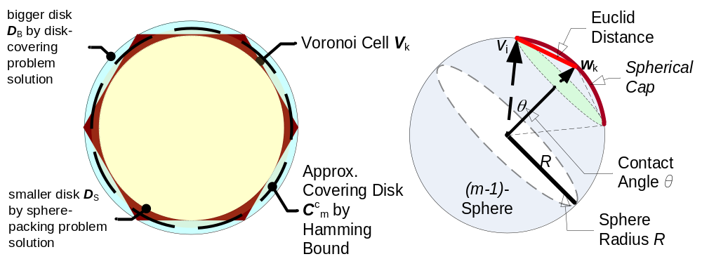
Codebook Voronoi Cell Boundary
Upper Bound: finding the bigger disk D_{U} – Disk Covering Problem:
  what is the smallest disk for covering Voronoi cell in a Voronoi diagram?
Lower Bound: finding the smaller disk D_{L} – Sphere Packing Problem:
  What is the largest disk covered by the Voronoi cell in a given Voronoi diagram?

Slide 12
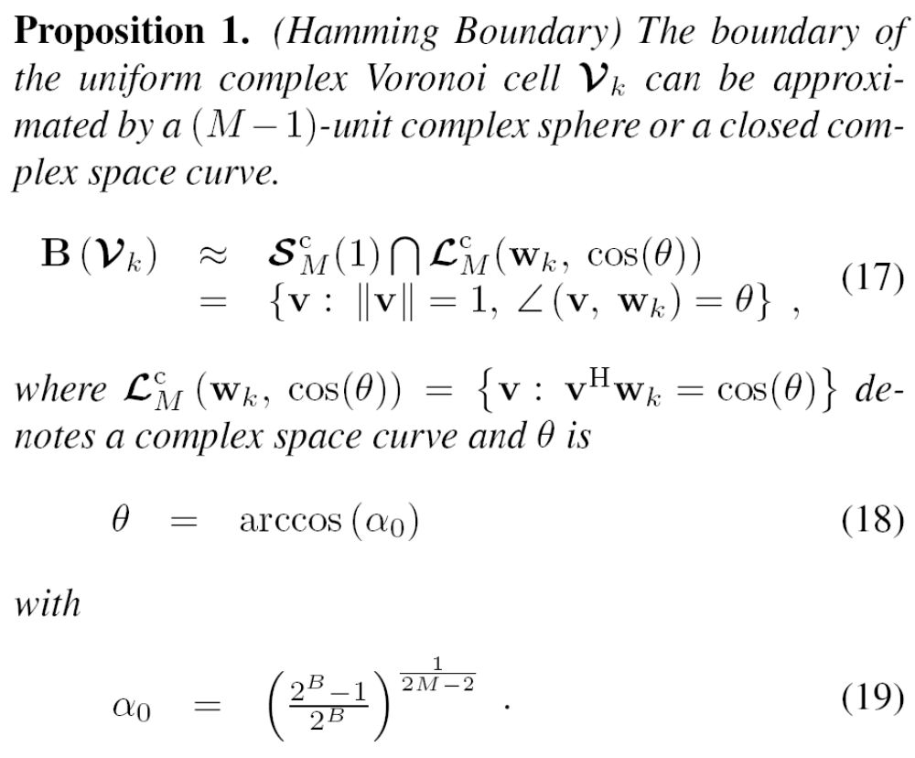
Hamming Bound on Codebook

Slide 13
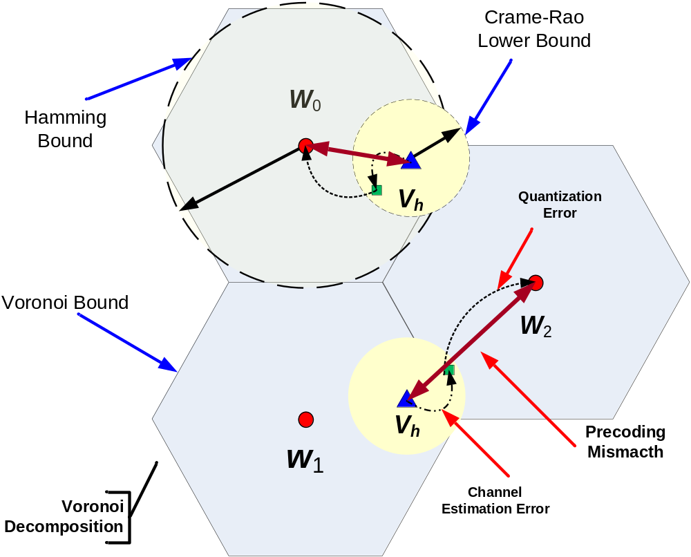
MIMO Precoding Mismatching – A Signal Processing Perspective

Slide 14
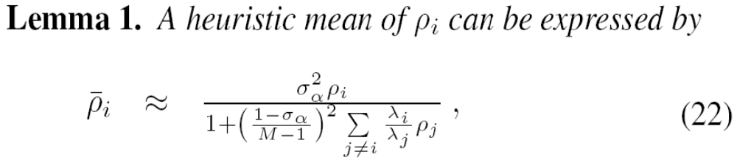
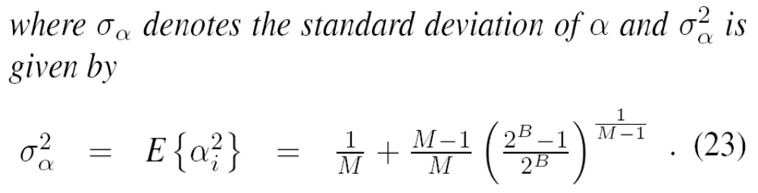
SINR with Precoding Mismatch

Slide 15
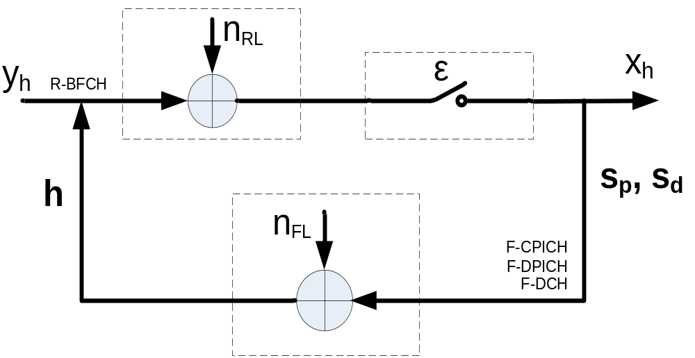
MIMO FB Chan. Model with Chan. Esti.
Feedforward Channel (R-BFCH):
  n_{RL}: CQICH Gaussian Noise
  ε: CQICH erasure rate
Feedback Channel (F-CPICH + F-DPICH + F-DCH)
  n_{RL}: Forwardlink Gaussian Noise

Slide 16
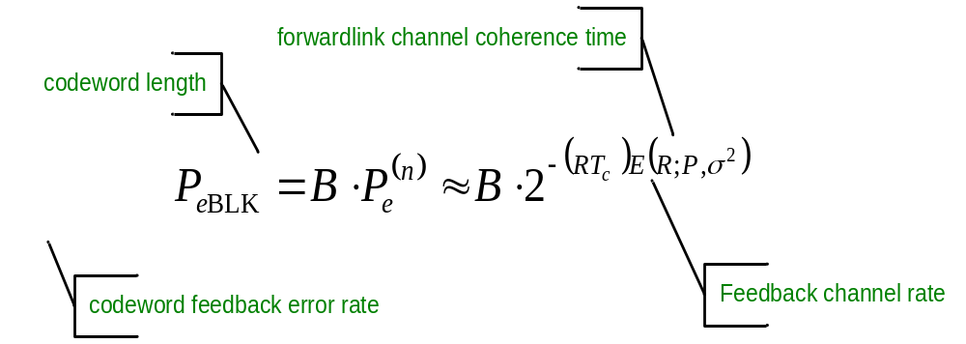
MIMO Precoding Mismatching – A Coding Perspective
What is the P_{eBLK} here? R-BFCH error rate.
For a codebook of size 2^{B}, the relationship between P_{eBLK} and feedback channel reliability roughly is

Slide 17
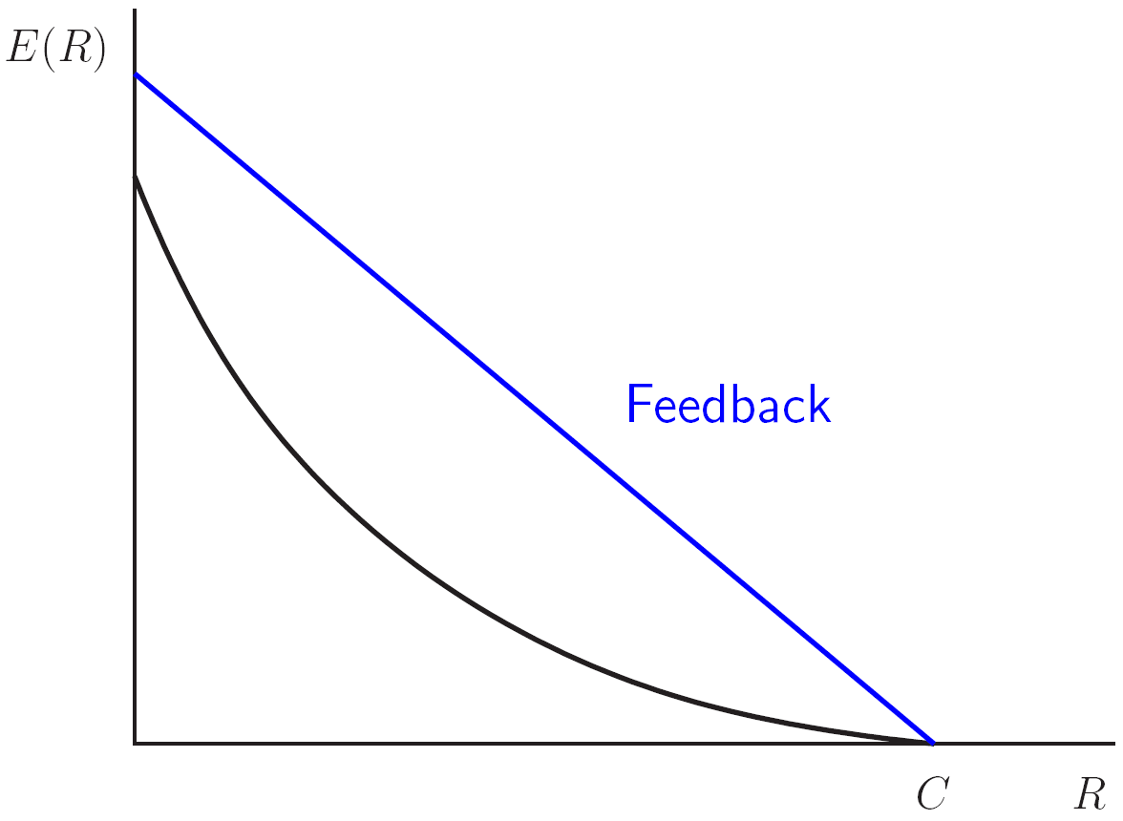
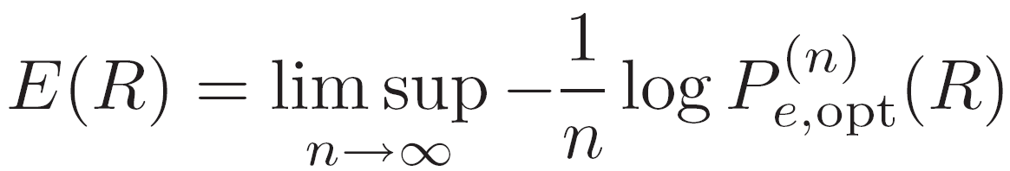
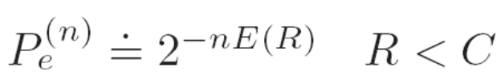
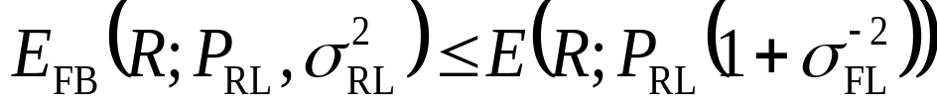
Reliability of Feedback Channel
The error probability of Gaussian Channel decays exponentially with the reliability E(R).
With feedback, high reliability possibly is achievable.
Noisy Feedback is much worse than perfect feedback.
Less forward-link channel estimation errors will possibly help improve R-BFCH reliability.

Slide 18
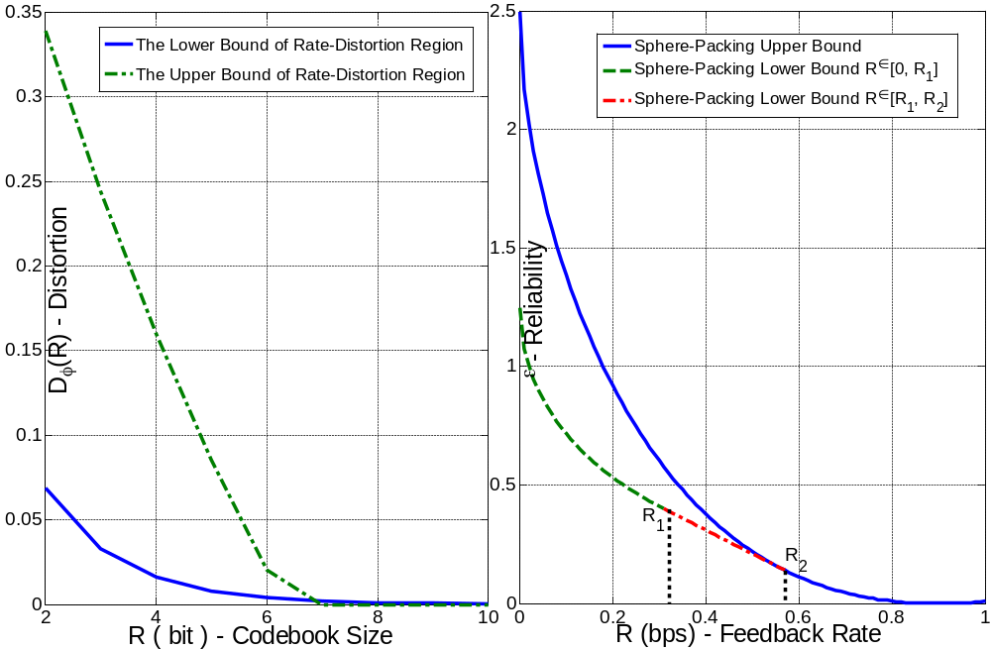
Rate, Distortion and Reliability

Slide 19
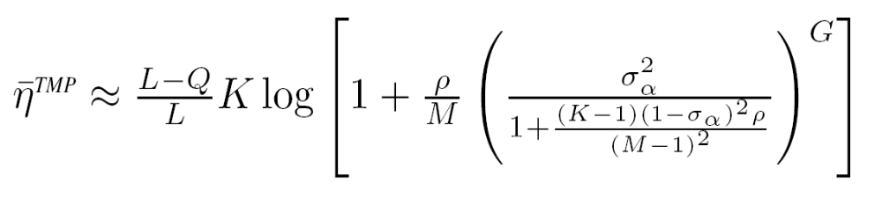
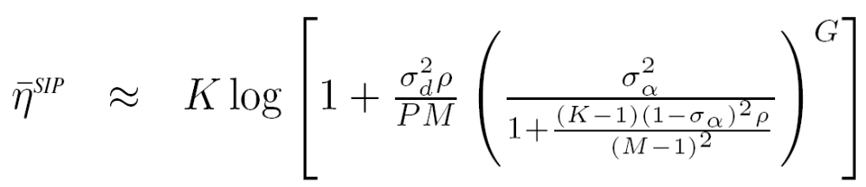
Spectral Efficiency of MIMO Relay Link (1/3)
MIMO Relay Assumptions:
Amplify-and-forward relay
No macro-diversity or cooperation between transmissions or groups.

Slide 20
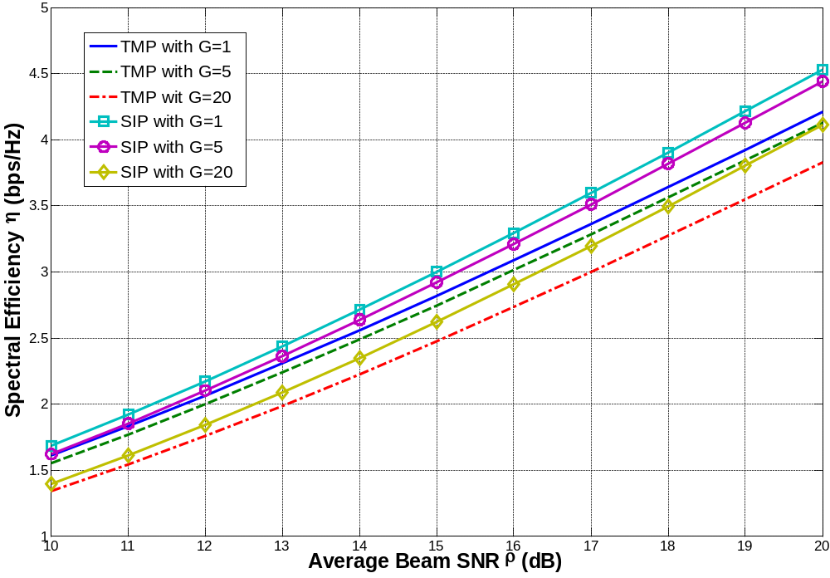
Spectral Efficiency of MIMO Relay Link (2/3)

Slide 21
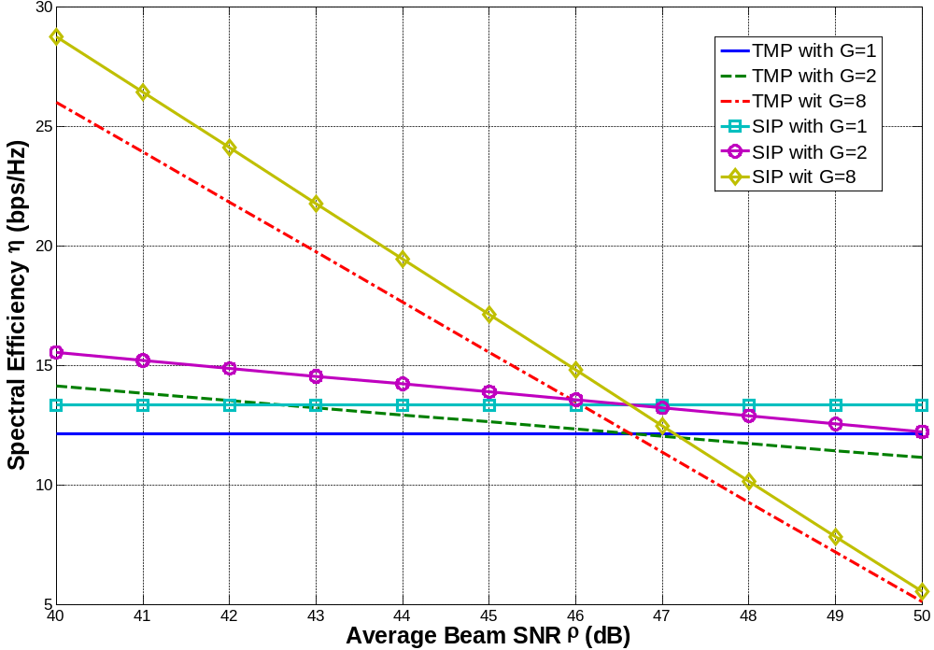
Spectral Efficiency of MIMO Relay Link (3/3)

Slide 22
Conclusions
MIMO precoding mismatch is a function of
  Codebook design: Voronoi cell/boundary
  Also the reliability of R-BFCH:
Both FL channel and RL channel design can affect the achievable rate R of R-BFCH.
  When FL with high SNR, the benefits of increasing RL reliability is similar as increasing FL power (FL/RL coupling)
  When FL with low SNR, RL design is more important than FL.
MIMO relay link spectral efficiency is a function of
  Pilot design: TMP/SIP
  Codebook size: larger codebook size is good in general
  The number of hops: more hops may not be good, and
    in high SNR region, more Tx power helps more.
    in high IBI region, more hops may helps more.
There may exist an important switch point in optimal relay routine algorithm design.

Slide 23
Thank you!

